Slide 1
Intro R Workshop and Study Group Introduction
Dr. Henry Renski
Landscape Architecture & Regional Planning
University of Massachusetts Amherst

Slide 2
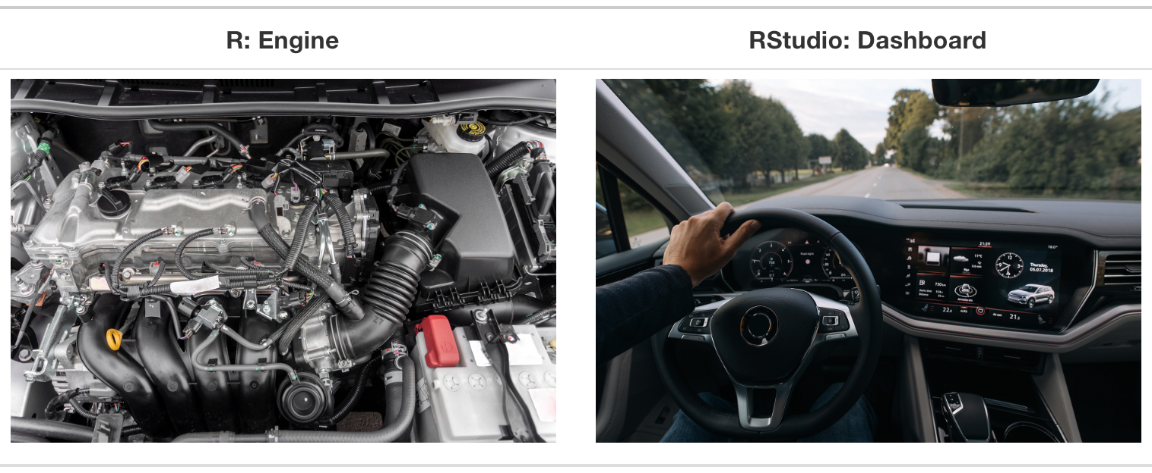
What is R?
R is an open-source programming language designed for data manipulation, visualization and statistics.
In class we will be accessing R via R Studio
Source: Ismay and Kim (2019) ModernDive: Statistical Inference via Data Science https://moderndive.com/1-getting-started.html

Slide 3
Why not just use excel?
Excel is fine when:
Ad hoc / one-off projects
Small datasets or entering your own data
Simple calculations or statistics
Better to code when:
Repeat the same/similar analysis many times
Manipulation/integration of large datasets
More sophisticated analytical & visualization methods
Literally thousands of user-written routines
Analytical integration

Slide 4
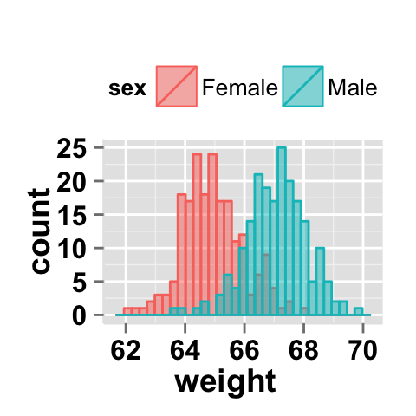
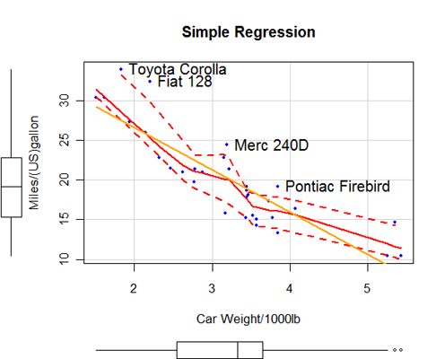
Common Statistical Methods

Slide 5
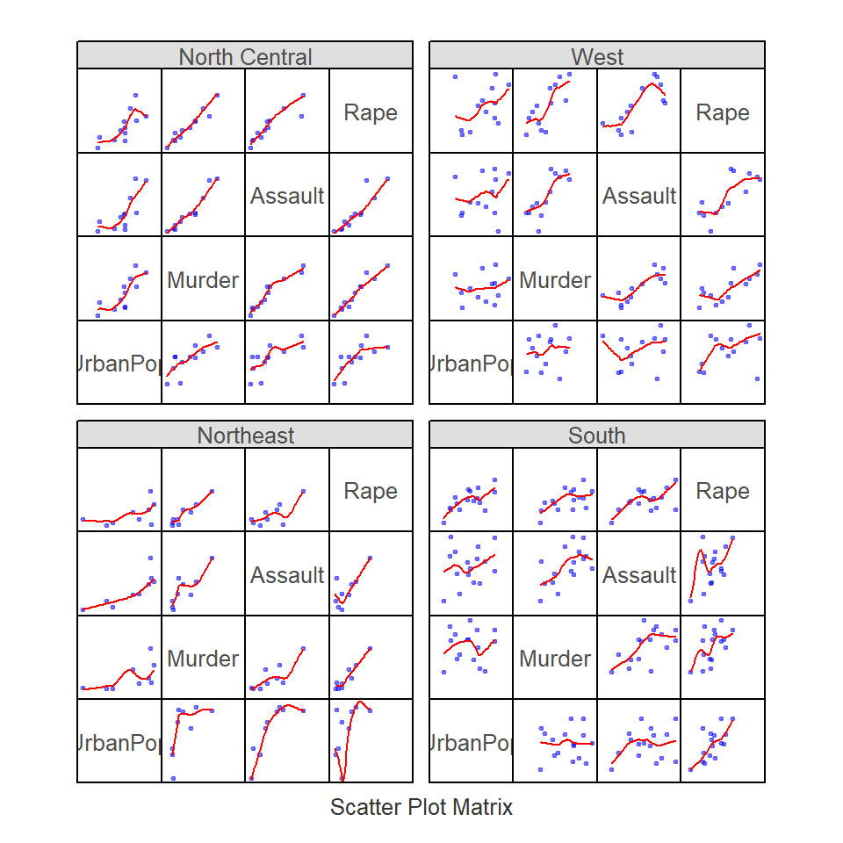
Data Visualization Methods

Slide 6
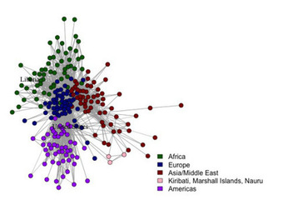
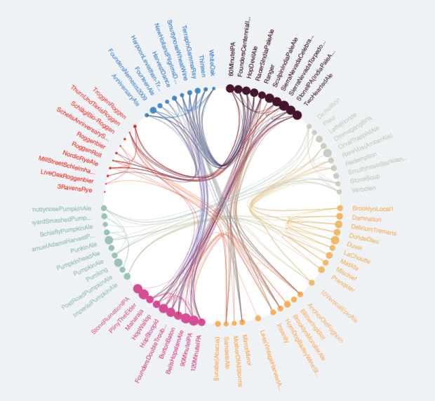
Network Analysis

Slide 7
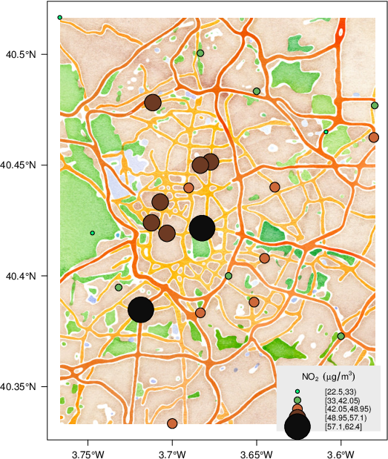
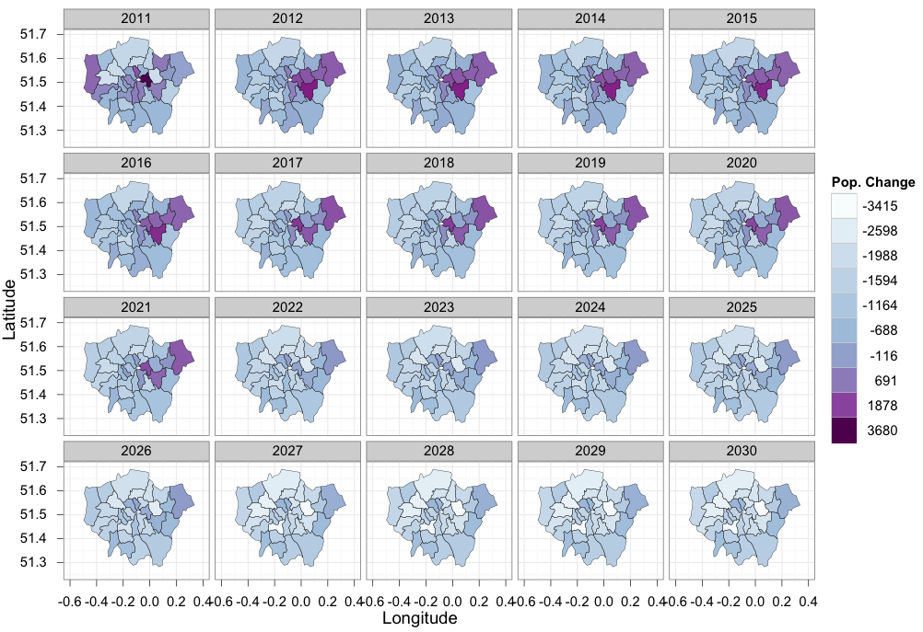
Spatial Data Analysis

Slide 8
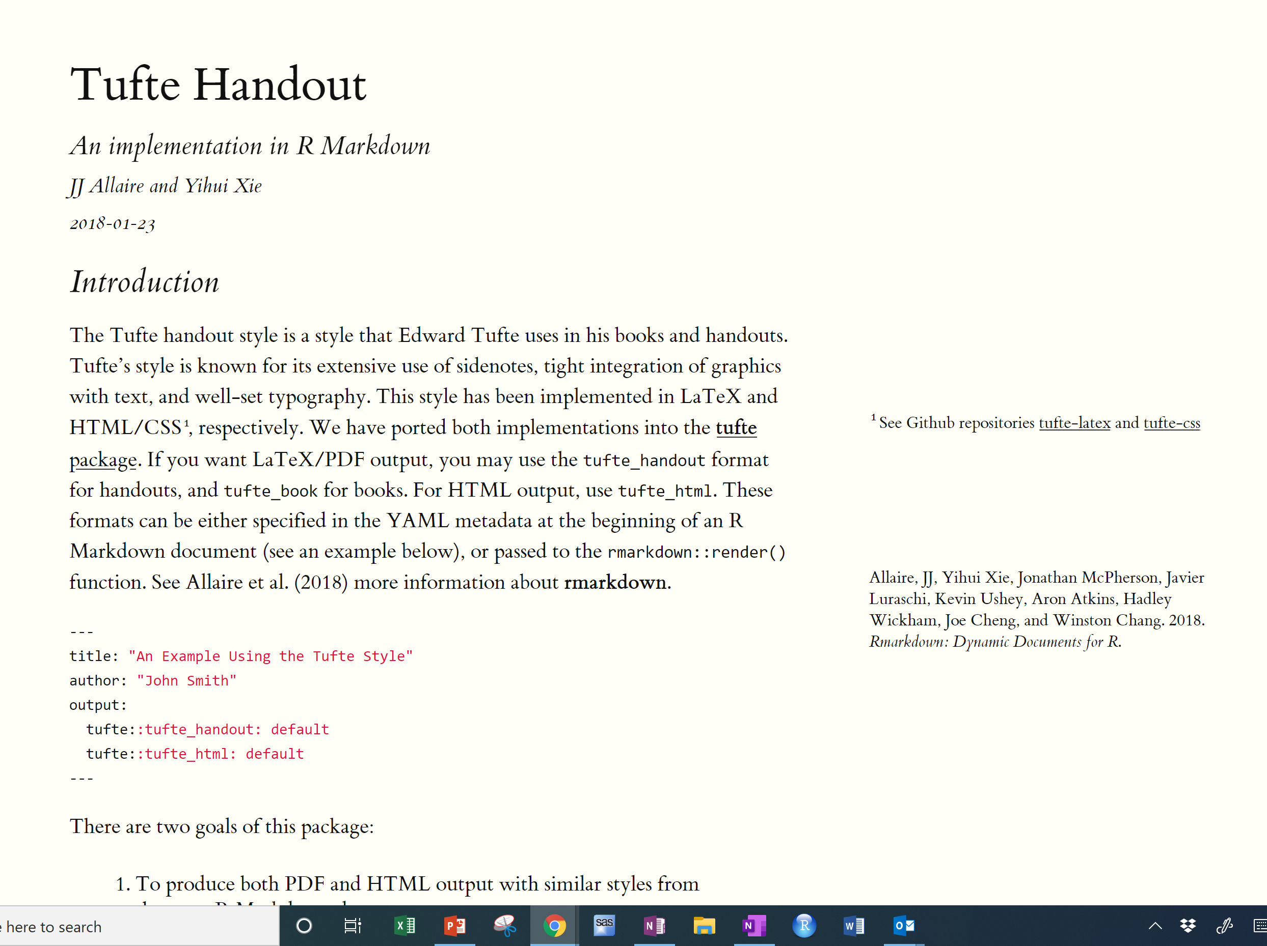
Really nice looking reports

Slide 9
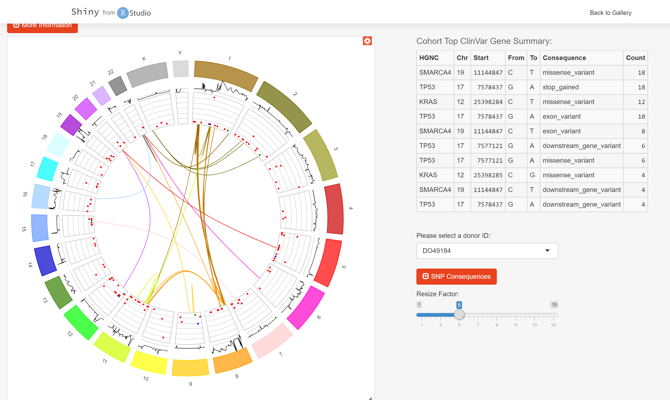
Interactive Data Dashboards

Slide 10
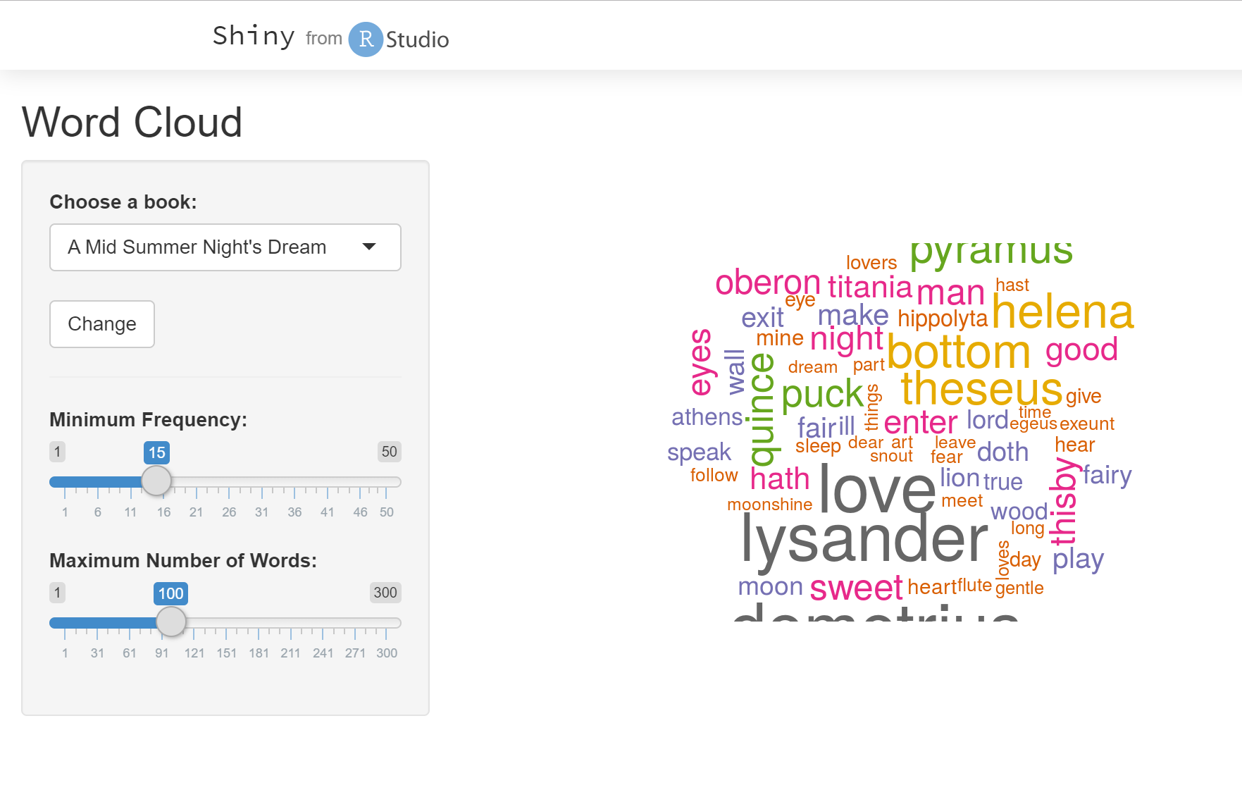
Content Analysis and Word Clouds

Slide 11
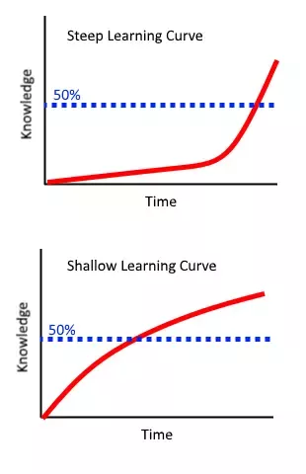
So what’s the problem?
R has literally thousands of user-written packages:
Design and publish integrated and interactive documents and reports (R Markdown)
Digital mapping and spatial analysis
Network analysis
(Content) analysis of texts / interviews (including Word Clouds)
Make and publish online data servers (shiny apps)
There is very a steep learning curve!!
You have to retrain your brain to think more logically and less GUI

Slide 12
Course Objectives
Become familiar with the R platform
R Studio Interface
Packages (mainly tidyverse in this class)
Understanding how to get help
Develop basic coding skills
Simple computations, syntax, & functions
Build data analysis skills via code
Import data from common planning sources
Data wrangling and cleaning
Visualization (charts, graphs, maybe maps)
Maybe some statistical analysis?
Notes:
Without timing you could have reverse causation
Confounding: two variables are connected through their mutual association with a third variable

Slide 13
Expectations
Weekly Tasks
Readings, Tutorials, other Coding Assignments
No graded work, but you’re not going to learn it unless you
Weekly Meetings
Brief review
Work through problems together, troubleshoot
Notes:
Without timing you could have reverse causation
Confounding: two variables are connected through their mutual association with a third variable

Slide 14
The R Studio Cloud Server
Normally, you would load R on your computer
Then install a dashboard (e.g. R Studio)
Download additional packages as needed
We will be using R Studio on the web
https://rstudio.cloud/
No need for you to load anything on your computer
I set up a class workspace on R Studio Cloud
You need to register w R Studio Cloud, and I’ll will then give you access to the class workspace
Notes:
Without timing you could have reverse causation
Confounding: two variables are connected through their mutual association with a third variable

Slide 15
Before next week…
Read
ModernDive Online Tutorial: Chapter 1 Getting Started with Data in R from ModernDive
https://moderndive.com/1-getting-started.html
Watch:
Intro to what R Studio is and why use it
https://www.youtube.com/watch?v=riONFzJdXcs&list=PLqzoL9-eJTNARFXxgwbqGo56NtbJnB37A&index=2&t=0s
Do:
Register with RStudio Cloud www.rstudio.cloud
I will send you a link to join the shared space for this class
Make sure you can access the class workspace
Next time we will start with the actual tutorials

